Slide 1
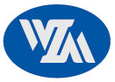
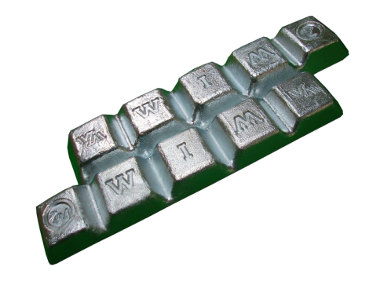
WONIL METAL CO.,LTD.
ZAMAK7
___________________________________________________________________________________________________________________________________
1. Chemical Composition(%)
구 분 | Al | Cu | Mg | Fe | Pb | Cd | Sn | Ni | Zn
Ingots | 3.9~4.3 | 0.03max | 0.01~0.02 | 0.075max | 0.003max | 0.002max | 0.001max | 0.005~0.02 | bal
DieCastings | 3.5~4.3 | 0.25max | 0.005~0.02 | 0.075max | 0.003max | 0.002max | 0.001max | 0.005~0.02 | bal
2. Mechanical properties
Tensile strength ( 引張强度 ) : Mpa | 283
Yield Strengh ( 降伏强度 ) 0.2% Offset : Mpa | 221
Elongation ( 伸率 ) : % in 2" | 13
Shear Strength ( 剪斷强度 ) : Mpa | 214
Hardness ( 硬度 ) : Brinell | 80
Impact Strength ( 衝擊强度 ) : J | 58
Fatigue Strength Rotary Bend-5x10⁸ cycles ( 疲勞强度 ) : Mpa | 47
Compressive Yield Strength 0.1% offset ( 壓軸降伏强度 ) : Mpa | 414
３. Physical Properties
Density:g/㎝³ ( 比重 ) | 6.6
Melting Range:℃ ( 鎔融範圍 ) | 381~387
Electrical Conductivity: % IACS ( 電氣傳導率 ) | 27
Thermal Conductivity: W/m/hr/℃ ( 熱傳導率 ) | 113
Coefficient of Thermal Expansion:100~200℃ ㎛/mm/℃ ( 熱膨脹 係數 ) | 27.4
4. Uses
5. Other name
From | ISO Traditional name | ASTM | KS / JIS | China | UK BS | Germany DIN | France NFA | European
Ingot | ZnAl4Ni / ZAMAK7 | AG40B | - | ZXO2 | - | - | - | -
cast |  |  | - |  |  |  |  | -
6. Dimension packing
Type 1. standard lngots
Slab : 8kg±1kg / EA , W * L * H = 450 mm * 42 mm * 90 mm
Bundle : 1000±10kg / EA , W * L * H = 450 mm * 550 mm * 990 mm
Type 2. standard Craw end lngots
Slab : 9kg±1kg / EA , W * L * H = 530 mm * 42 mm * 90 mm
Bundle : 1000±10kg / EA , W * L * H = 530 mm * 893 mm * 990 mm

