Slide 1
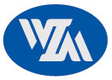
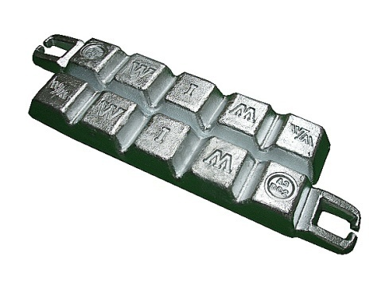
WONIL METAL CO.,LTD.
ZAMAK3 / ZDC2
___________________________________________________________________________________________________________________________________
1. Chemical Composition(%)
구 분 | Al | Cu | Mg | Fe | Pb | Cd | Sn | Zn
Ingots | 3.9~4.3 | 0.03max | 0.03~0.06 | 0.075max | 0.003max | 0.002max | 0.001max | bal
DieCastings | 3.5~4.3 | 0.25max | 0.02~0.05 | 0.1max | 0.005max | 0.004max | 0.003max | bal
2. Mechanical properties
Tensile strength ( 引張强度 ) : Mpa | 283
Yield Strengh ( 降伏强度 ) 0.2% Offset : Mpa | 221
Elongation ( 伸率 ) : % in 2" | 10
Shear Strength ( 剪斷强度 ) : Mpa | 214
Hardness ( 硬度 ) : Brinell | 82
Impact Strength ( 衝擊强度 ) : J | 58
Fatigue Strength Rotary Bend-5x10⁸ cycles ( 疲勞强度 ) : Mpa | 48
Compressive Yield Strength 0.1% offset ( 壓軸降伏强度 ) : Mpa | 414
３. Physical Properties
Density:g/㎝³ ( 比重 ) | 6.6
Melting Range:℃ ( 鎔融範圍 ) | 381~387
Electrical Conductivity: % IACS ( 電氣傳導率 ) | 27
Thermal Conductivity: W/m/hr/℃ ( 熱傳導率 ) | 113
Coefficient of Thermal Expansion:100~200℃ ㎛/mm/℃ ( 熱膨脹 係數 ) | 27.4
4. Uses
Automotive Parts, Toys, Office Equipment, House-hold Utensil, Building hard-ware, Electric home appliances, V.T.R-Drumbase, CP Connector, Construction ornaments, Padlocks, etc
5. Other name
From | ISO Traditional name | ASTM | KS / JIS | China | UK BS | Germany DIN | France NFA | European
Ingot | ZnAl4 / ZAMAK3 | AG40A | Ingot type2 | ZXO1 | AlloyA/ 1004A | Z400 | Z-A4 | ZL0400
cast |  |  | ZDC2 |  |  |  |  | ZP0400
6. Dimension packing
Type 1. standard lngots
Slab : 8kg±1kg / EA , W * L * H = 450 mm * 42 mm * 90 mm
Bundle : 1000±10kg / EA , W * L * H = 450 mm * 550 mm * 990 mm
Type 2. standard Craw end lngots
Slab : 9kg±1kg / EA , W * L * H = 530 mm * 42 mm * 90 mm
Bundle : 1000±10kg / EA , W * L * H = 530 mm * 893 mm * 990 mm

